Slide 1

ER Events Prediction
By Jaideep
Mentor: Rick Zhong

Slide 2

“
Big data is a supporting technology for data science. And data science is a supporting craft for better decision making.
”
Foster Provost, co-author of Data Science for Business

Slide 3

Not enough data…..

Slide 4

Problem Statement
To predict how likely is a patient to go the ER next year based on their past year’s medical data.

Slide 5

Dataset
The dataset has 360985 rows and 518 columns
The problem is modelled as a binary classification problem.
The target variable is ER events. The classes are High risk and low risk.

Slide 6






PROCESS FLOW
Parameter Tuning
Optimize the model hyperparameters based on the validation results
Data Collection
Data Pre-processing
Model Building
Validation
Results
Collecting raw data
Clean and prepare the data for model building.
Select suitable ML model based on the problem statement
Validate the model to ensure that it works on unseen data and to prevent over/under fitting
Predictions and variable importance from the machine learning model

Slide 7
Problem:
Class Imbalance
Why is it a problem?
The model will be biased to predict ‘low risk’ most of the time because it gets better accuracy

Slide 8
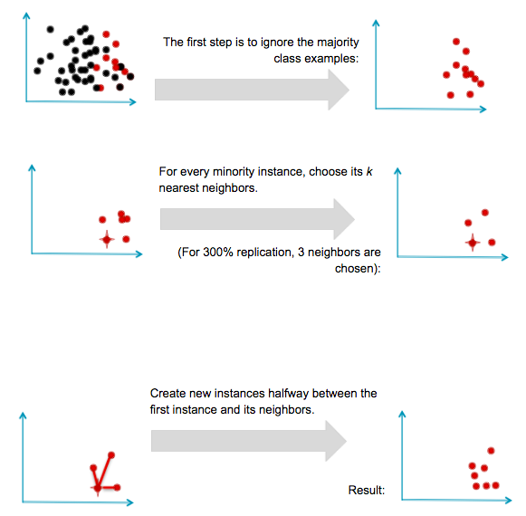
Oversampling
Synthetic Minority Oversampling Technique

Slide 9

How to train your Machine Learning model

Slide 10
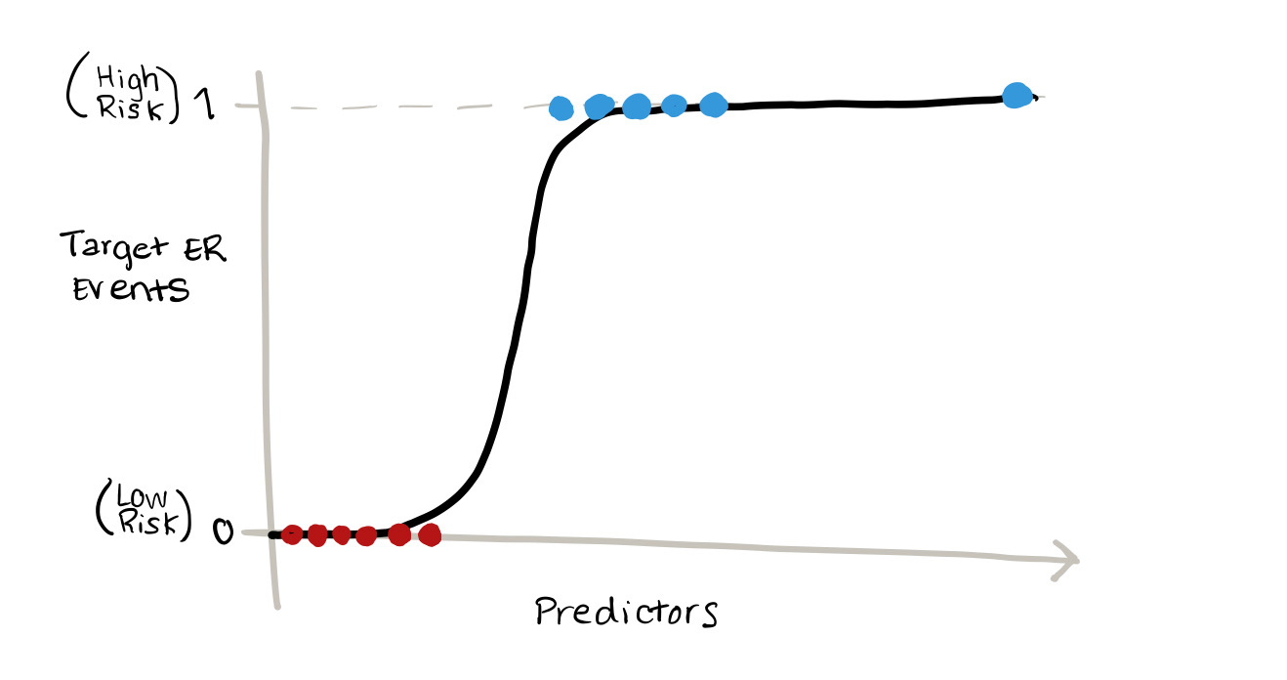
Logistic Regression
Lasso Regularization
0 : Low risk
1: High risk

Slide 11
Evaluating Performance
AUC
63%
71%
Before SMOTE
After SMOTE
Recall
34%
67%
Before SMOTE
After SMOTE

Slide 12
Osteoporosis Risk
Number of ER Visits
Number of Chronic Diseases
Gender= Male
Months since flu shot
Significant Variables

Slide 13
Comparing different models
Model | AUC Scores
Baseline Logistic Regression | 0.63
Baseline Neural Networks | 0.66
Logistic Regression after Oversampling | 0.71

Slide 14

Here’s why Neural Nets are awesome
Fake faces created by Nvidia’s Generative Advisory Networks (GAN).
None of these people are real.

Slide 15

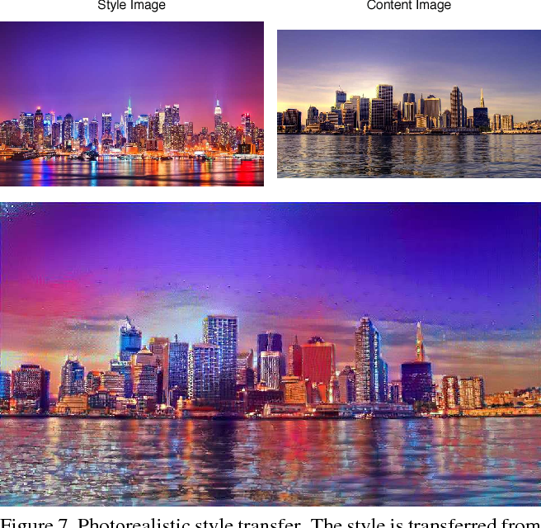

Slide 16
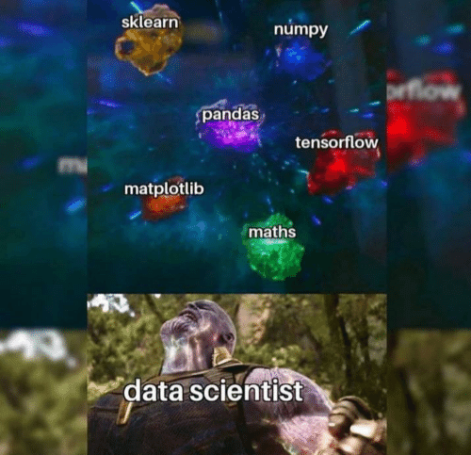
What have I learnt?
Working on real data
NumPy
Pandas
Sklearn
SciPy
TensorFlow
Sampling techniques
Pipelining

Slide 17
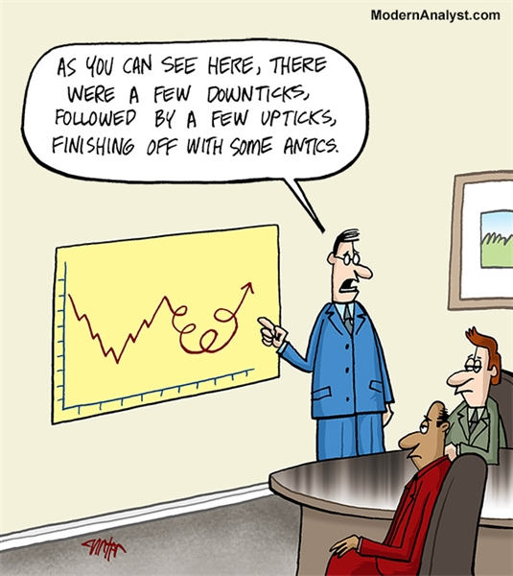
Conclusion

Slide 18


